Slide 1
Miscellaneous Topics
Section 1
Chapter 6
© 2016 Pearson Education, Ltd. All rights reserved.

Slide 2
Exceptions
Exceptions (runtime errors) occur due to circumstances beyond programmer's control
  Example 1: Invalid data are input
  Example 2: File cannot be accessed
Even though might be user’s fault
  Example: If a user enters a word when the program prompts for a number, an exception is generated and the program terminates abruptly
  It is programmer’s responsibility to anticipate exceptions and to include code to work around the occurrence

Slide 3
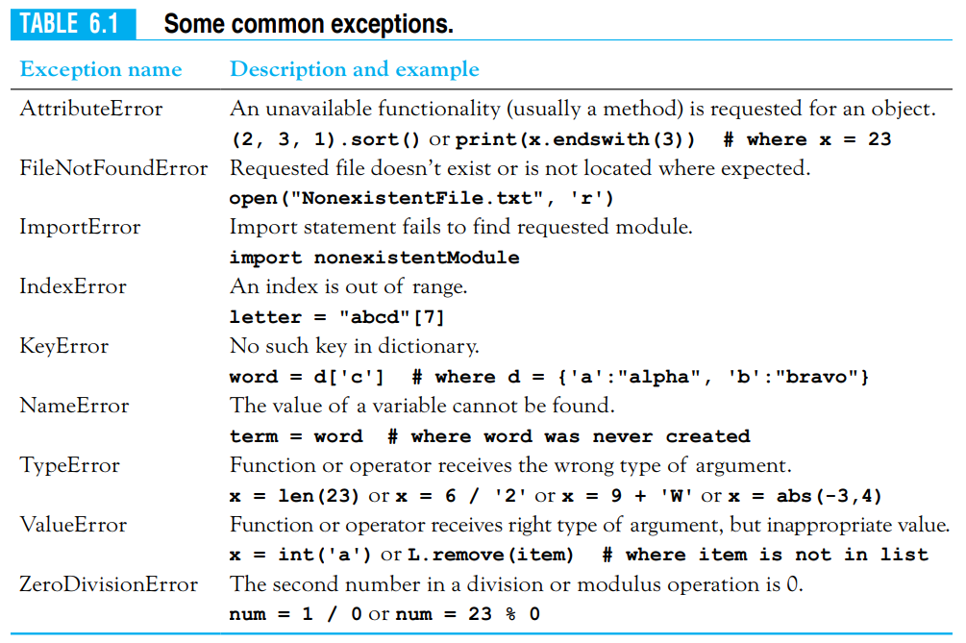

Slide 4


Exceptions
  Entry may be non numeric or just <Enter> key
  Python gives following error message
  The first word in the line gives the type of the error and the rest of the line provides details on the cause of the error.
  The exception was raised because the input value, the empty string, cannot be converted to an integer

Slide 5
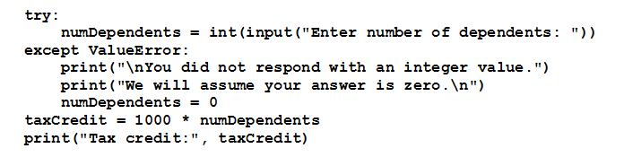
The try Statement
Robust program explicitly handles previous exception
  Protecting the code with a try statement.
  Python first attempts to execute the code in the try block. If a ValueError exception occurs, execution jumps to the except clause. Whether an exception occurred or not, the code in the last two lines will be executed.

Slide 6
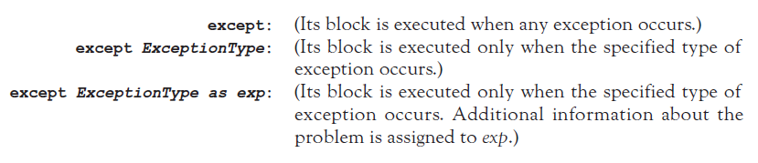
The try Statement
A try statement can contain several except clauses.
Three types of except clauses:
If the try statement discussed earlier, had the except clause been
except ValueError as exc:
then the variable exc would have been assigned the type of exception—in this case invalid literal for int() with base 10: ''.
© 2016 Pearson Education, Ltd. All rights reserved.

Slide 7
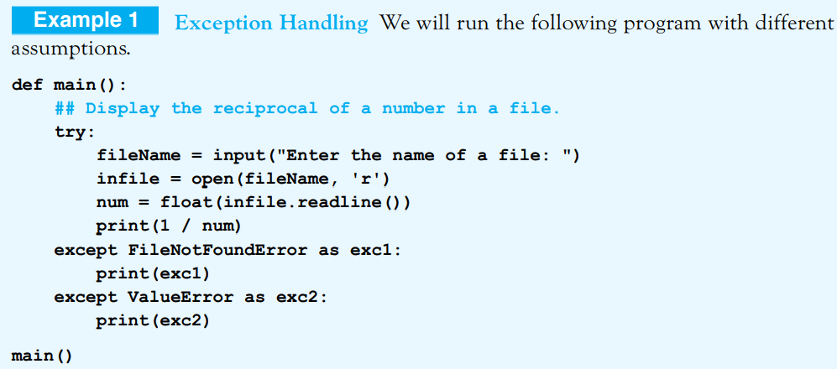
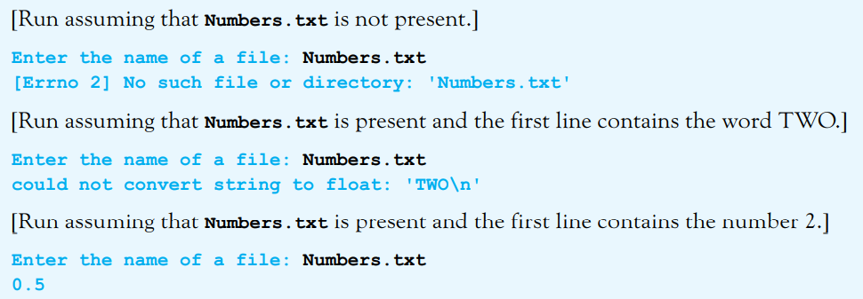
© 2016 Pearson Education, Ltd. All rights reserved.

Slide 8
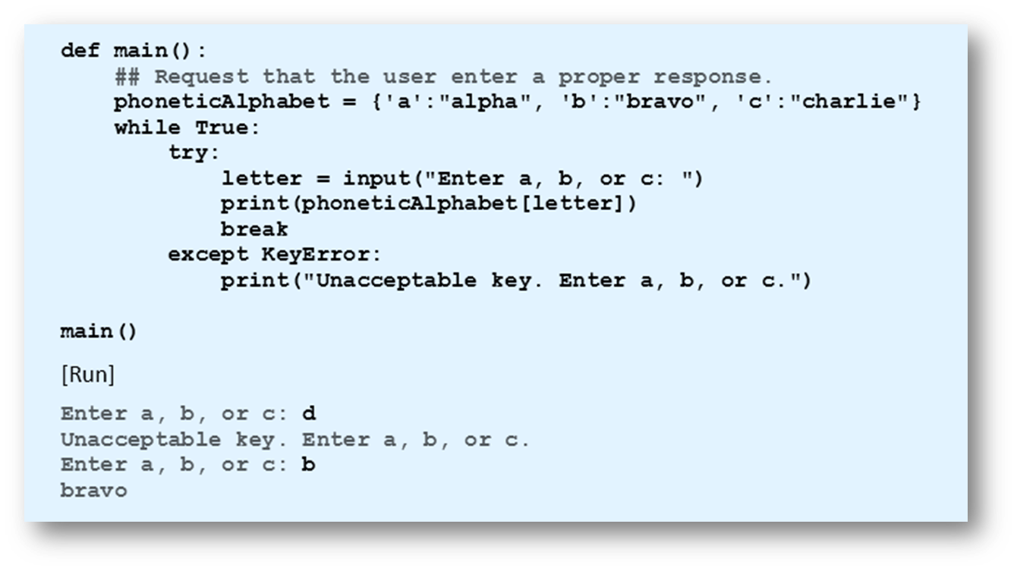
The try Statement
Example 2: Program uses exception handling to guarantee proper response from user.
© 2016 Pearson Education, Ltd. All rights reserved.

Slide 9
The else and finally Clauses
try statement also can include a single else clause
  Follows the except clauses
  Executed when no exceptions occur
try statement can end with a finally clause
  Usually used to clean up resources such as files that were left open
try statement must contain either an except clause or a finally clause.
© 2016 Pearson Education, Ltd. All rights reserved.

Slide 10
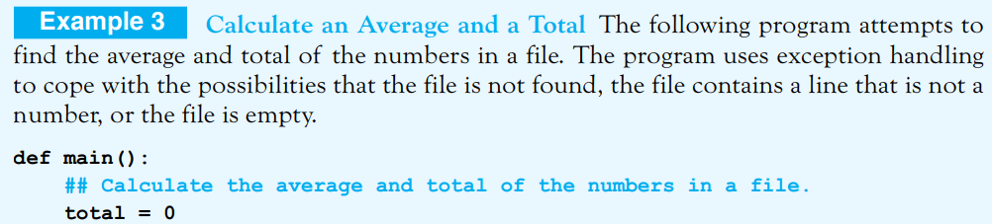
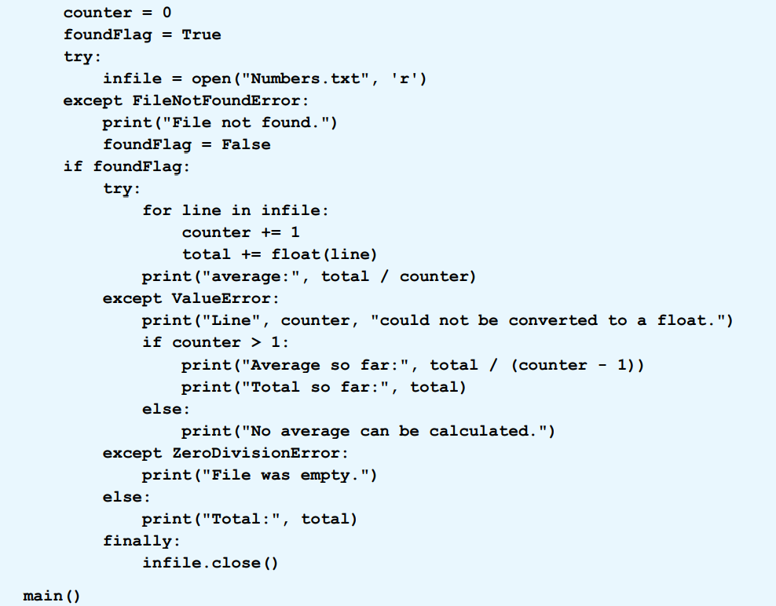
© 2016 Pearson Education, Ltd. All rights reserved.

Slide 11
End
Section 1
Chapter 6
© 2016 Pearson Education, Ltd. All rights reserved.

